Slide 1
Car evaluation Project
BY Shusil Bk
London met Id: 23048939

Slide 2

Artificial Learning Platforms
We explore three primary AI learning approaches: Supervised, Unsupervised, and Semi-supervised learning. These concepts, studied in our college module and through extensive research, form the foundation of modern AI.

Slide 3

Supervised
Learning
Labeled Data
Algorithms train on data with known input features and correct output labels.
Pattern Recognition
Training & Prediction
Discovers input-output patterns for accurate predictions on new data.
Involves learning from examples and applying that knowledge.

Slide 4





Unsupervised Learning
Unlabeled Data
Pattern Discovery
Algorithms uncover hidden patterns without explicit correct answers.
Automatically identifies clusters, groups, or associations in data.
Exploratory Analysis
Explores unknown data distributions to reveal concealed forms.

Slide 5




Semi-Supervised Learning
Hybrid Approach
Combines small amounts of labeled data with large quantities of unlabeled data.
Efficiency
More efficient when labels are costly or tedious to obtain.
Model Enhancement
Supervised learning is enhanced with unsupervised steps like clustering.

Slide 6
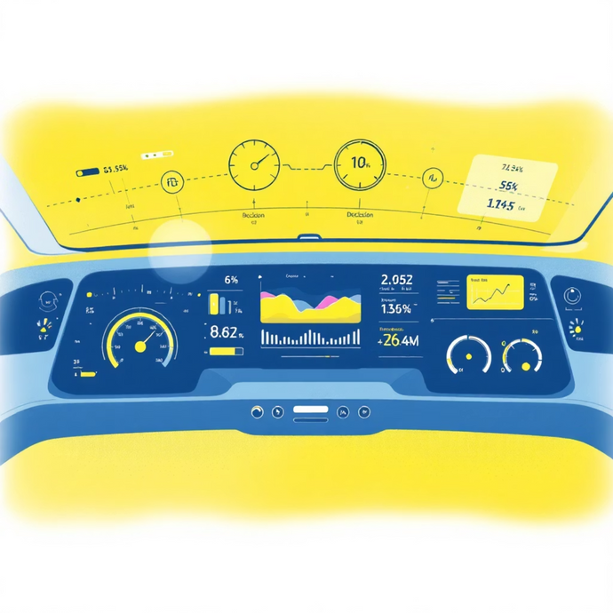
Car Evaluation Dataset: Problem Domain
The Car Evaluation dataset assesses vehicle acceptability based on multi-criteria decision-making. It categorises outcomes as unacceptable, acceptable, good, or very good, countering traditional expert opinions with objective, rule-based classifications.
This dataset is ideal for testing classification algorithms on balanced, categorical data, serving as a benchmark for decision trees and rule learners.

Slide 7
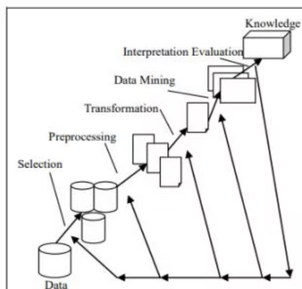
Case Study: Jain et al. (IJCA 2017)
Jain et al. benchmarked the UCI Car Evaluation dataset using RapidMiner. They split the data 80-20 to create performance baselines for accuracy, precision, recall, and F1-score, comparing various classifiers.
77.99%
81.27%
86.49%
K-NN
Random Forest
Naive Bayes
88.80%
91.12%
Rule Induction
Decision Tree

Slide 8
Widyana et al. (JATIT 2022)
Widyana et al. introduced missing values (0-50%) to the Car Evaluation dataset to simulate incomplete data. Their study focused on k-Nearest Neighbor Imputation (k-NNI) with decision tree variants to assess model robustness.
C5.0 + k-NNI
Achieved 96.82% accuracy, even with 50% missing values, demonstrating superior performance and speed.
Imputation Necessity
Catastrophic accuracy collapse without imputation, confirming its crucial role.

Slide 9

Alwadi et al. (PMC 2022)
Alwadi et al. proposed an interpretable AI framework for vehicle quality assessment. They integrated black-box models with post-hoc explainable AI (XAI) techniques like SHAP and LIME to interpret predictions.
1
SVM
0.98 F1-score (BEST) with RBF kernel on categorical hyperspace.
2
Random Forest
~90% balanced accuracy due to ensemble strength.

Slide 10
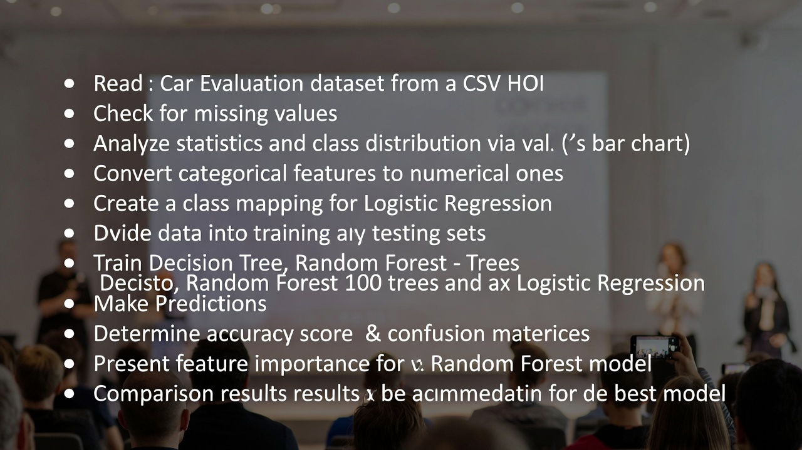
PseudoCodes of the project

Slide 11
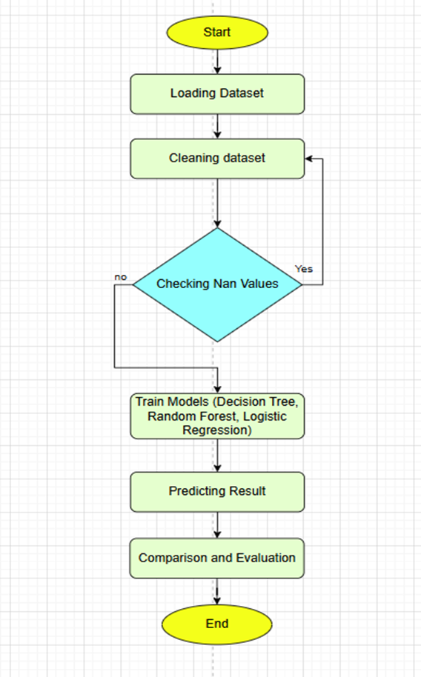
Pseudocode

Slide 12
Real World Solutions
Helps car buyers make informed decisions based on safety, cost, and usability.
Enables automated car recommendation and classification in online platforms.
Assists manufacturers in analyzing cost–quality trade-offs during design and reduces human bias by providing objective, data-driven car evaluations.

Slide 13
Conclusion & Future Enhancements
The project successfully predicted car acceptability using supervised ML. Random Forest achieved the highest accuracy (97.4%), outperforming Logistic Regression (65.9%).
Key Learnings
Tree-based models excel with categorical data; data preprocessing is crucial for model compatibility.
Future Work
Implement SMOTE for class imbalance, integrate XAI (SHAP/LIME), and explore real-time deployment.

